Slide 1

ML Models for Failure Detection and Predictive Maintenance
Group 2, 25.01.2025

Slide 2
Agenda
1. Data Collection and Preprocessing
2. Random Forest Model
3. Logistic Regression Model
4. MLP Model
5. Results and Evaluation

Slide 3
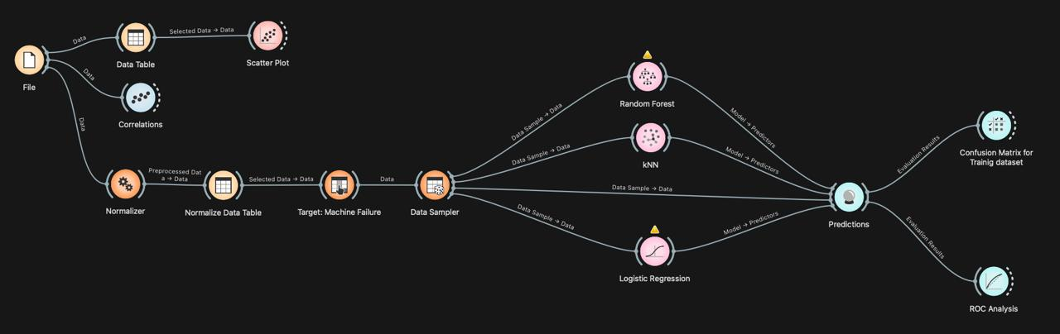
Project Pipeline

Slide 4
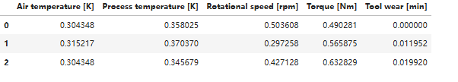
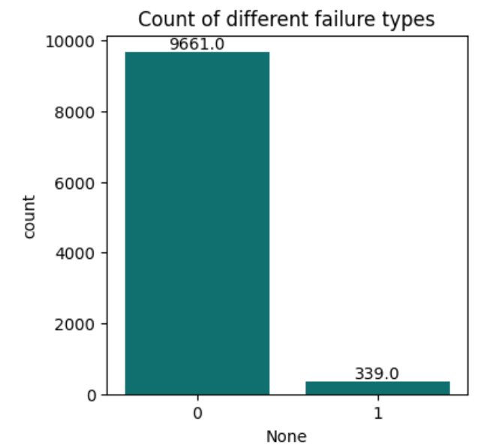
Data Collection & Preprocessing
1
Data Collection
AI4I 2020 Predictive Maintenance Dataset augmented with more collected data
2
Data Exploration
Check basic structure and stats
3
Distribution of Failure Modes
Focus on combined 'Machine failure' feature
4
Data Augmentation
SMOTE for over-sampling minority classes

Slide 5
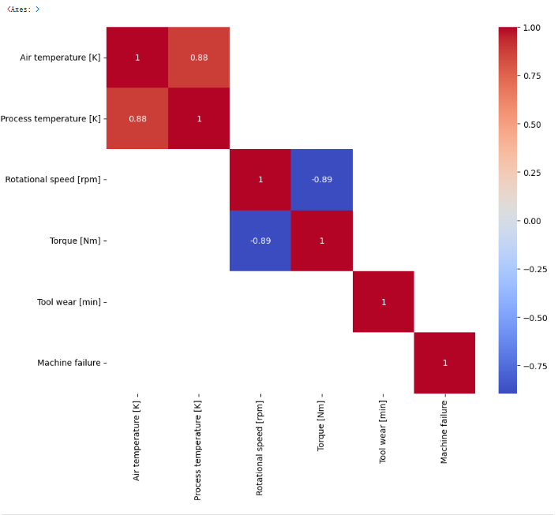
Data Collection & Preprocessing
5
Handling Outliers and Anomaly Detection
IQR (interquartile range)
Local Outlier Factor LOF algorithm
6
Data normalization
7
Correlation analysis
8
Feature selection
Determine the best features that represent the dataset to use them for training

Slide 6

A random forest consists of multiple decision trees.
Ensemble training:
1. Bootstrap Sampling: each tree is trained with a random subset of the training data
2. Random Feature Selection
3. Prediction: each tree is grown to its maximum depth to make predictions
4. Voting: The predictions from each tree are combined using voting to produce the final output.
Random Forest Model
https://blog.tensorflow.org/2021/05/introducing-tensorflow-decision-forests.html

Slide 7
Logistic Regression
Learn weights similarly as in linear regression.
Predict conditional class probabilities based on model weights
Minimize the cost function by Regularization.
https://towardsdatascience.com/logistic-regression-explained-and-implemented-in-python-880955306060

Slide 8
Multi Layer Perceptron
MLPs are a type of fully connected artificial neural networks composed of :
Input Layer
Hidden Layers
Output Layer
Some important features:
Activation function
Learning algorithm (Backpropagation algorithms, genetic algorithm, etc.)
Number of layers, neurons, batches, epochs, etc.
…
https://medium.com/@Suraj_Yadav/in-depth-knowledge-of-convolutional-neural-networks-b4bfff8145ab

Slide 9
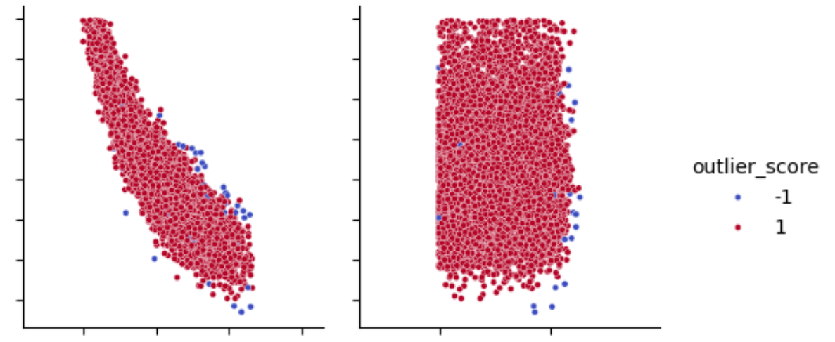
Machine Learning Tasks
We carried out the following ML tasks:
Regression
Classification
Anomaly Detection

Slide 10
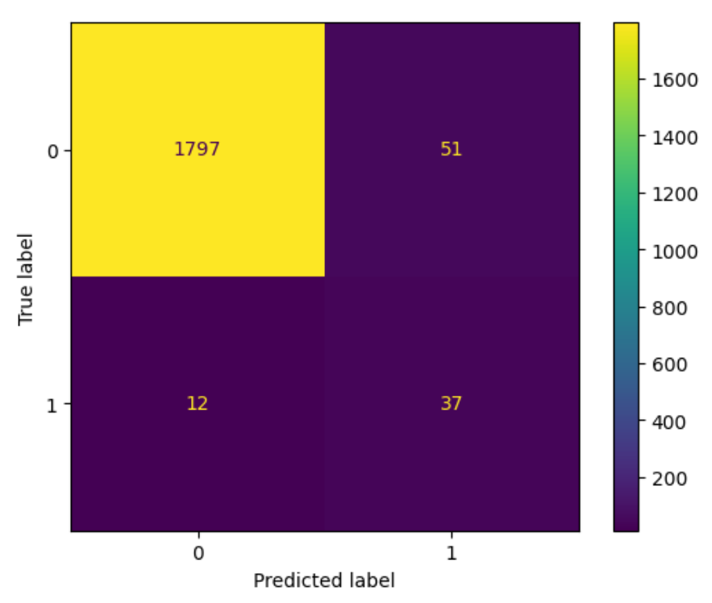
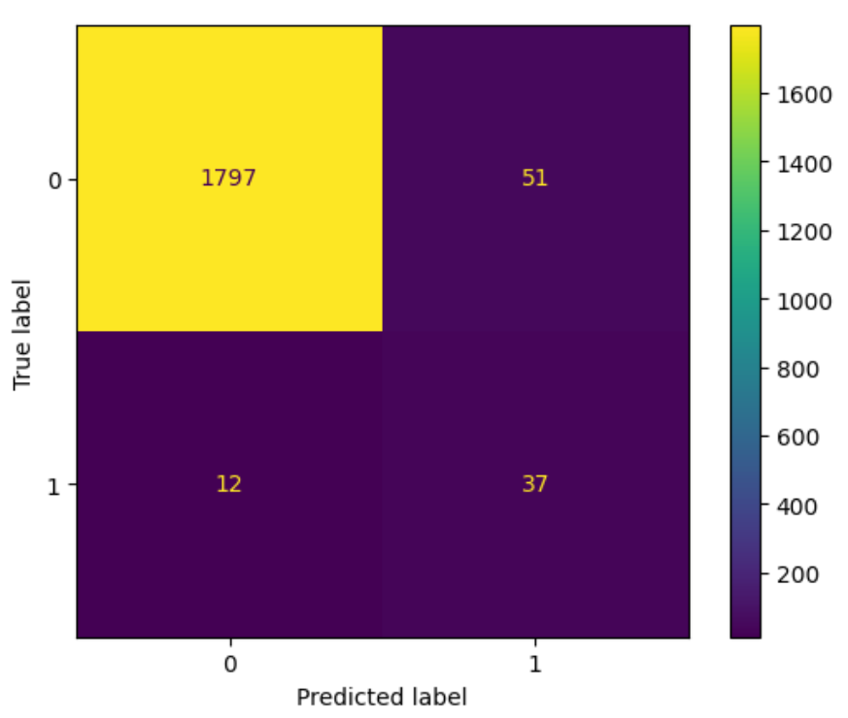
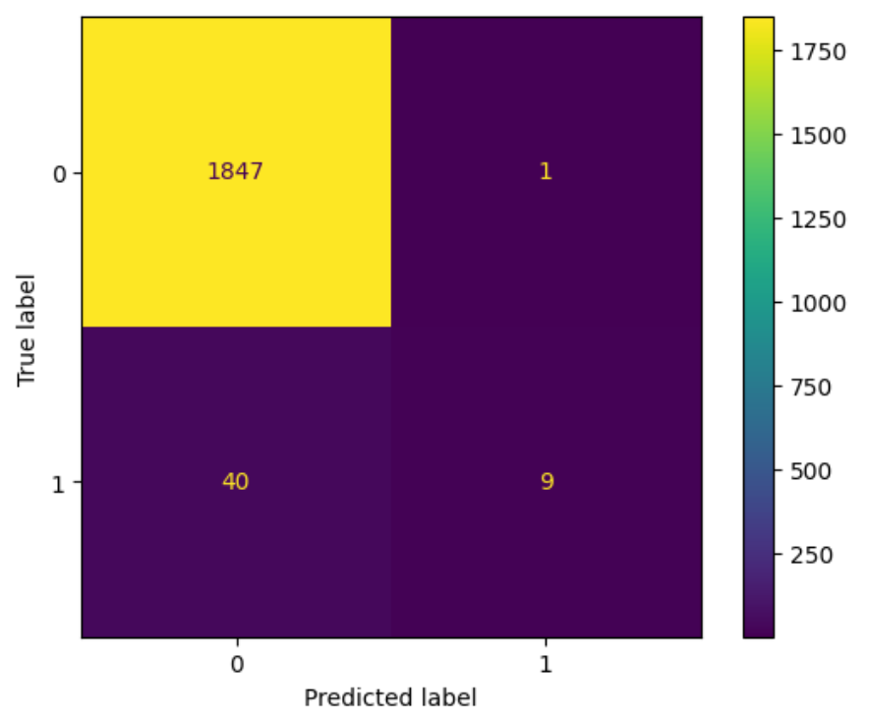
Results and Evaluation
Confusion Matrix
Random Forest Logistic Regression MLP

Slide 11
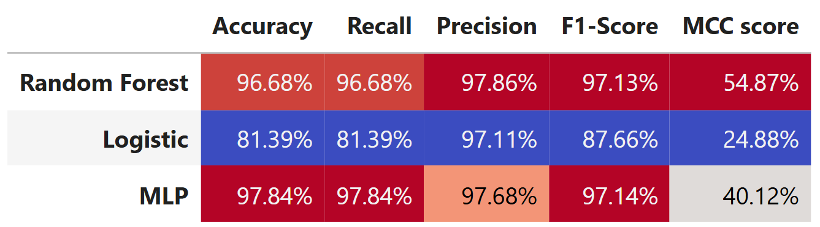
Results and Evaluation
Classification Report

Slide 12
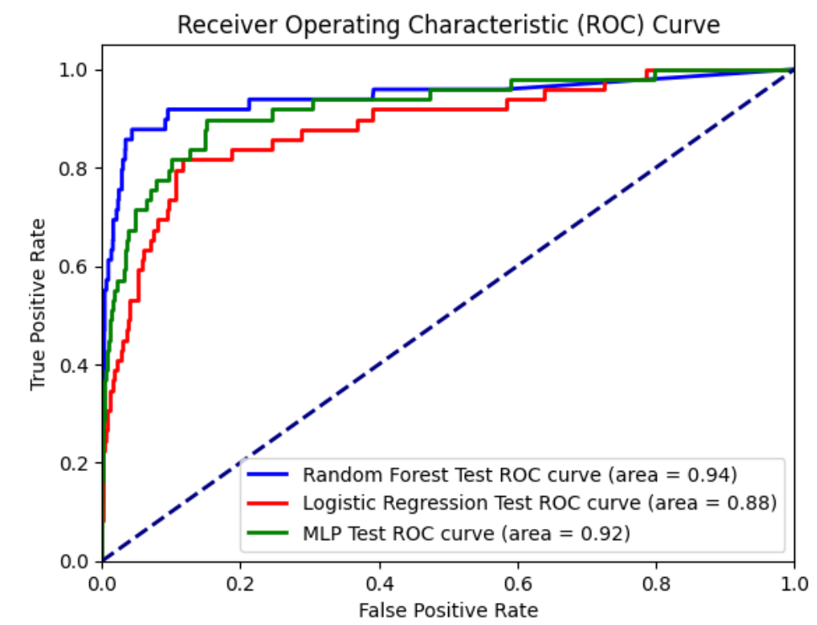
Results and Evaluation
ROC Curve

